Slide 1
Minimum Cost to Connect Two Groups of Points
This problem involves finding the minimum cost to connect two groups of points, where the cost of connecting any two points is given in a matrix. The goal is to ensure that each point in both groups is connected to at least one point in the opposite group.

Slide 2


.
Formal Problem Statement
1
Two Groups of Points
The first group has size1 points, and the second group has size2 points, with size1 >= size2.
2
Connection Costs
The cost of connecting any two points is given in an size1 x size2 matrix, where cost[i][j] is the cost of connecting point i in the first group and point j in the second group.
3
Connectedness Requirement
There must be a connection between every point in the first group and every point in the second group, and a connection between every point in the second group and every point in first group

Slide 3

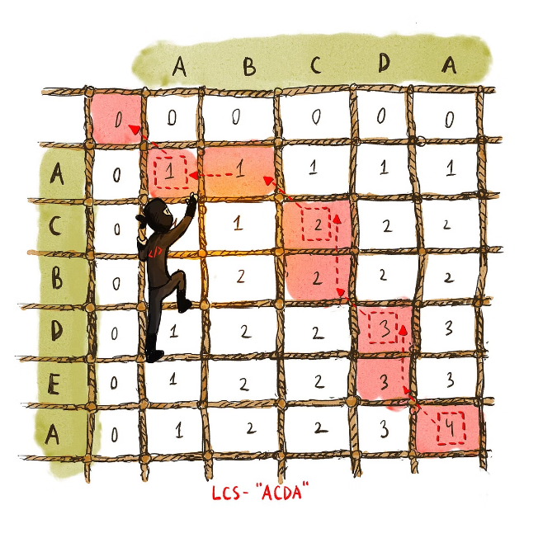
Dynamic Programming Approach
1
Subproblems
Define subproblems that capture the minimum cost to connect the first i points in the first group to the first j points in the second group.
2
Recurrence Relation
Develop a recurrence relation that expresses the minimum cost in terms of the minimum costs of smaller subproblems.
3
Bottom-Up Computation
Use a bottom-up dynamic programming approach to compute the minimum cost, building up the solution from smaller subproblems.

Slide 4

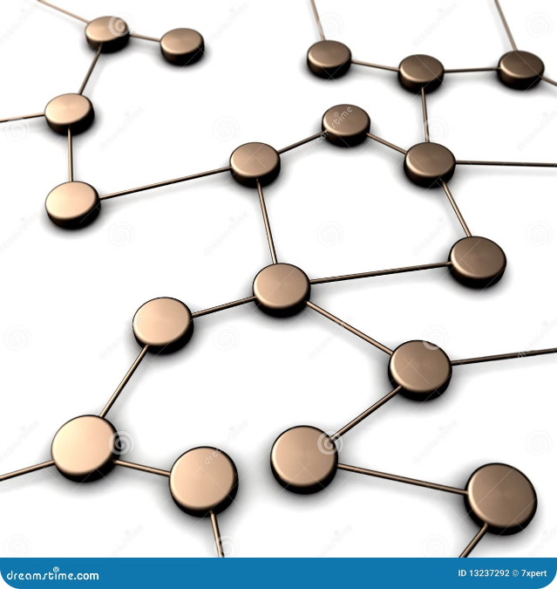
Example
Input
cost = [[15, 96], [36, 2]]
Output
17
Explanation
The optimal way to connect the groups is: 1--A, 2--B, with a total cost of 17.

Slide 5

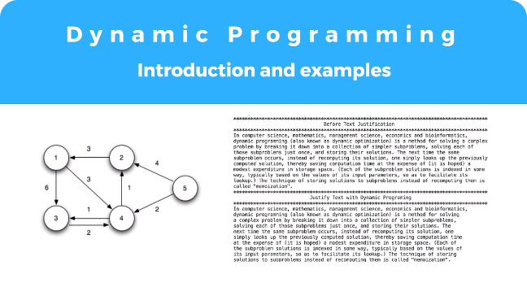
Dynamic Programming Solution
1
Initialize
Create a 2D array dp to store the minimum costs for the subproblems.
2
Compute
Fill in the dp array using the recurrence relation, starting from the base cases.
3
Return
The final answer is the value stored in dp[size1][size2].

Slide 6

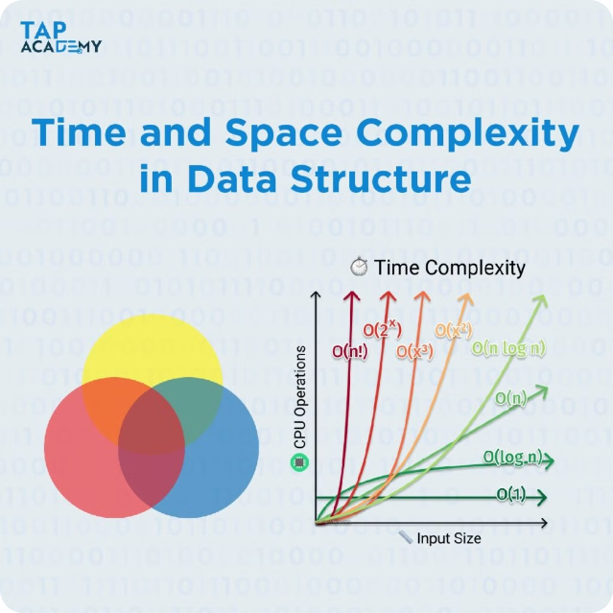
Time and Space Complexity
1
Time Complexity
O(size1 * size2), as we fill in the dp array using the recurrence relation.
2
Space Complexity
O(size1 * size2), as we use a 2D array to store the subproblem solutions.

Slide 7


Optimizations and Extensions
Optimizations
Potential optimizations include using memoization or a sparse matrix representation to reduce the space complexity.
Extensions
The problem can be extended to consider other constraints, such as a maximum number of connections per point or a budget limit.

Slide 8





Conclusion
Key Takeaways
The minimum cost to connect two groups of points can be solved using a dynamic programming approach, which involves defining subproblems and a recurrence relation.
Optimization Potential
There are opportunities to optimize the solution further, such as using memoization or sparse data structures.
Problem Extensions
The problem can be extended to consider additional constraints, making it a versatile and useful tool in various applications.

